Slide 1
Final Project Presentation
Wesley Wichman

Slide 2
Table of Contents
Build another model different from term 3 – Level Designer
Implement a view in Winforms using statically laid out components – Level Designer
Implement a view in Winforms using dynamically laid out components – Level Designer
Implement a view in Winforms using statically laid out components – File Handler
Combine your application with the other two applications created by other students
Compare and contrast the features and uses of different programming languages

Slide 3
Level Designer Must features Model – Level Designer
Can set selection as wall
Can set selection as empty space
Can set selection as place
Can set selection as goal
Can set selection as block
Can set selection as block on goal
Can set selection as player on goal
Place a wall in correct position
Place empty space in correct position
Place player in correct position
Place goal in correct position
Place block in correct position
Place block on goal in correct position
Place player on goal in correct position
Must be able to overwrite an item
Display errors
Too many players
No player
Not enough blocks for goals
There are no goals
Can save
Can load
Check player exists
Check goal exists
Check same or more amount of blocks as goals
Check only 1 player exists

Slide 4
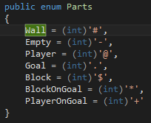

Level Designer Must feature Model
Can set selection as wall
An enumerator exists with each part defined as the correct character, when the function “seItem” is used it set the property to the correct part e.g. wall.
Selected item property
Function to set the selected item
Enumerator with each part

Slide 5
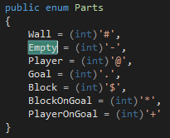
Level Designer Must feature Model
Can set selection as empty space
An enumerator exists with each part defined as the correct character, when the function “seItem” is used it set the property to the correct part e.g. empty space.
Selected item property, levelEditor.cs
Function to set the selected item
Enumerator with each part, parts.cs

Slide 6
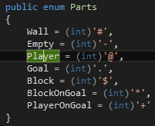
Level Designer Must feature Model
Can set selection as player
An enumerator exists with each part defined as the correct character, when the function “seItem” is used it set the property to the correct part e.g. player.
Selected item property
Function to set the selected item
Enumerator with each part

Slide 7
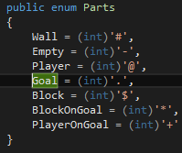
Level Designer Must feature Model
Can set selection as goal
An enumerator exists with each part defined as the correct character, when the function “seItem” is used it set the property to the correct part e.g. goal.
Selected item property
Function to set the selected item
Enumerator with each part

Slide 8
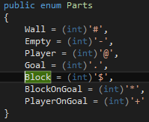
Level Designer Must feature Model
Can set selection as block
An enumerator exists with each part defined as the correct character, when the function “seItem” is used it set the property to the correct part e.g. block.
Selected item property
Function to set the selected item
Enumerator with each part

Slide 9
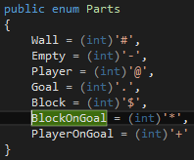
Level Designer Must feature Model
Can set selection as block on goal
An enumerator exists with each part defined as the correct character, when the function “seItem” is used it set the property to the correct part e.g. block on goal.
Selected item property
Function to set the selected item
Enumerator with each part

Slide 10
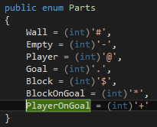
Level Designer Must feature Model
Can set selection as player on goal
An enumerator exists with each part defined as the correct character, when the function “seItem” is used it set the property to the correct part e.g. player on goal.
Selected item property
Function to set the selected item
Enumerator with each part

Slide 11

Level Designer Must feature Model
Place wall in correct position
After an item has been set, the place item function will be used. This function will need the position for x and y on the map array, it will then change the value to the set item.
The map array property
The place item function

Slide 12
Level Designer Must feature Model
Place empty in correct position
After an item has been set, the place item function will be used. This function will need the position for x and y on the map array, it will then change the value to the set item.
The map array property
The place item function

Slide 13
Level Designer Must feature Model
Place player in correct position
After an item has been set, the place item function will be used. This function will need the position for x and y on the map array, it will then change the value to the set item.
The map array property
The place item function

Slide 14
Level Designer Must feature Model
Place goal in correct position
After an item has been set, the place item function will be used. This function will need the position for x and y on the map array, it will then change the value to the set item.
The map array property
The place item function

Slide 15
Level Designer Must feature Model
Place block in correct position
After an item has been set, the place item function will be used. This function will need the position for x and y on the map array, it will then change the value to the set item.
The map array property
The place item function

Slide 16
Level Designer Must feature Model
Place block on goal in correct position
After an item has been set, the place item function will be used. This function will need the position for x and y on the map array, it will then change the value to the set item.
The map array property
The place item function

Slide 17
Level Designer Must feature Model
Place player on goal in correct position
After an item has been set, the place item function will be used. This function will need the position for x and y on the map array, it will then change the value to the set item.
The map array property
The place item function

Slide 18
Level Designer Must feature Model
Must be able to overwrite an item
After an item has been set, the place item function will be used. This function will need the position for x and y on the map array, it will then change the value to the set item, this will overwrite any previous value.
The map array property
The place item function

Slide 19

Level Designer Must feature Model
Can get the map to be saved
A function exists that will get the map array, this will retrieve the current state of the map, passing all the characters in their current positions.
The get map function will return the map

Slide 20

Level Designer Must feature Model
Can set a map to be loaded
A function exists that will set the map array, this will overwrite any previously defined map allowing the loaded one to be used.
Set map function will be used for loading a map

Slide 21
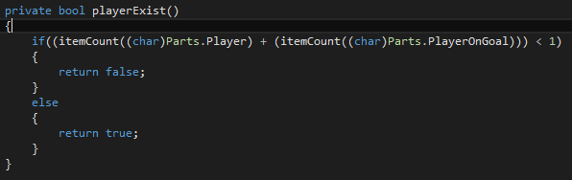
Level Designer Must feature Model
Check if player exists
In the error checker there is a function that will first get the map then check through it to see if the character for player exists anywhere within the array.
Player exists function will return false if there are no players found in the array

Slide 22
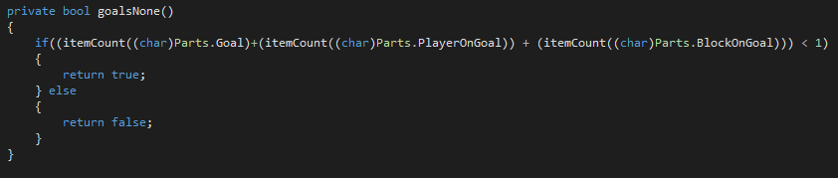
Level Designer Must feature Model
Check if goal exists
In the error checker there is a function that will first get the map then check through it to see if the character for goal exists anywhere within the array.
Goals none function will return true if there are no goals found in the array

Slide 23
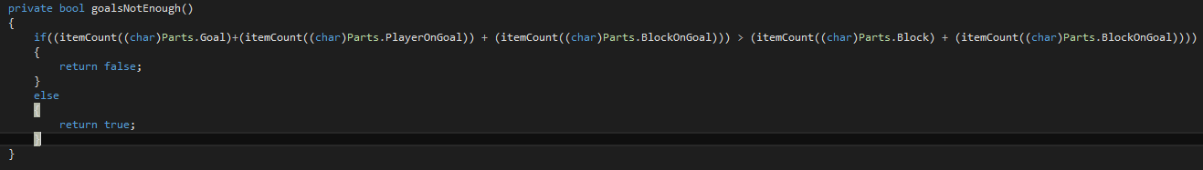
Level Designer Must feature Model
Check enough blocks exist for goals
In the error checker there is a function that will first get the map then check through it to see if there are enough blocks to place on the goals.
Goals not enough function will return false if there are not enough blocks

Slide 24
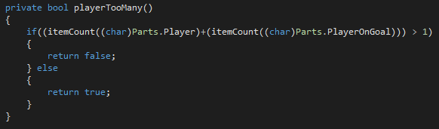
Level Designer Must feature Model
Check no more than 1 player exists
In the error checker there is a function that will first get the map then check through it to see if there is only 1 player that exists
Player too many function will return false if there are too many players

Slide 25
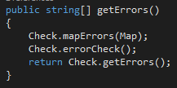

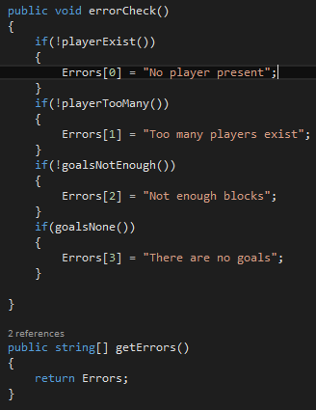
Level Designer Must feature Model
Return errors
The error checker will first take the current map, run the checks, then if there is an error, it will add it to an array at a certain position, if there is not an error then it will be null. The level designer model will run the functions needed in the error checker then return the array containing the errors.
The error checker function that takes the current map array
Get errors function will run the required functions in the error checker
The error check function, which will run the checks and the get errors function

Slide 26
Level Designer Must features Static
Display a grid of variable size
Allow selection and placement of an item
Overlays old piece with new one
Save and load words
Useful warnings
No goals
No player
Too many players
Not enough blocks

Slide 27
Level Designer Should Static
Each item placed displays an image
Buttons can only be clicked when valid
When map has been generated ‘check’ can be clicked
When there are no errors, save can be clicked

Slide 28
Level Designer Must feature Static
Display grid of variable size
The map grid is generated after setting a size for the width and height of the level then clicking the ‘generate’ button. For the static view, a data grid is already created and contains 30 rows and columns. The default is just set to the same colour for the border, background and selection, when the user clicks a selection, the select colour will change to match and when clicking, the cell background colour will change to match.

Slide 29
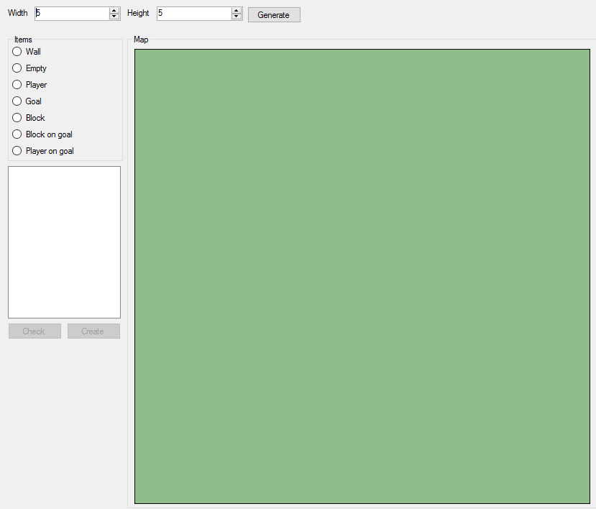
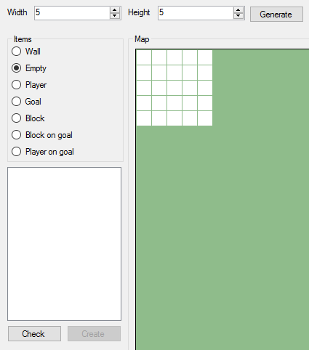
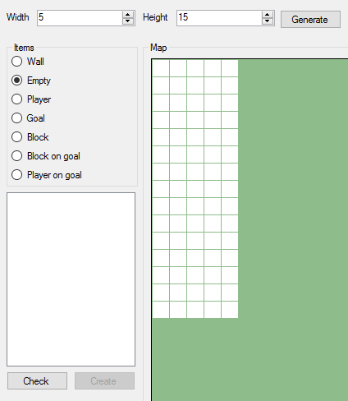
Level Designer Pictures Static
Fig 1. When starting the designer
Fig 2. After clicking generate
Fig 3. Changing height and clicking generate

Slide 30
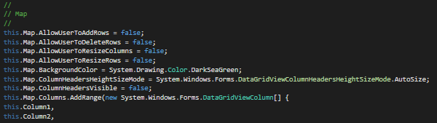
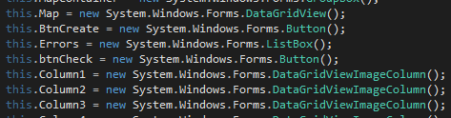

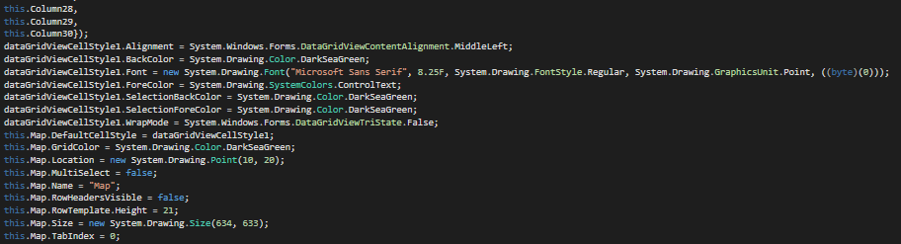
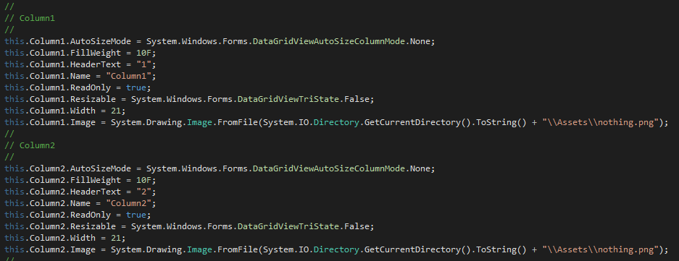
Level Designer Code Static
First, a “DataGridView” and 30 DataGridView image columns are created and defined as “Map” and “Column1”, “Column2”, “Column3” etc. The Map and Column settings are then set.

Slide 31
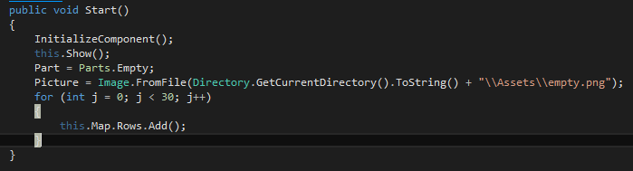
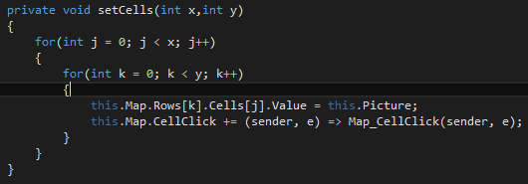
Level Designer Code Static
When the model “start” function is used, 30 rows are added. This creates a grid with 30 by 30 cells, creating the maximum amount of positions needed for a map. When the width and height are passed in, by pressing “generate”, they use the “SetCells” function to change the cell images, showing the user the available map positions and adding an event for when the cell is clicked.

Slide 32
Level Designer Must feature Static
Allow selection and placement of a piece
Overlays old piece with a new one
There is a selection panel that will only allow a single item to be selected at a time, when something is selected, then a position on the map is clicked, the background will change to suit the selected item. As each item is placed, it will overwrite the previous value whether it is empty or contains another piece.

Slide 33
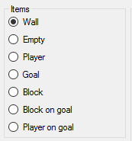
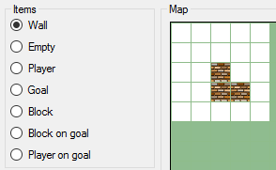
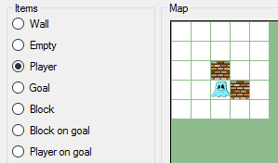
Level Designer Pictures Static
Fig 1. Selection panel
Fig 2. Item has been clicked and placed in the map
Fig 3. Wall item has been overwritten with a player selection

Slide 34
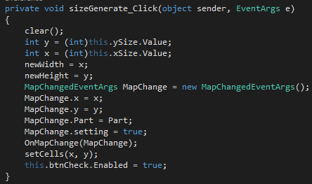
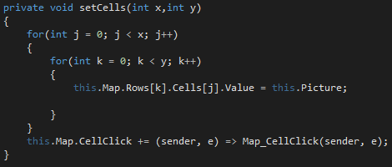
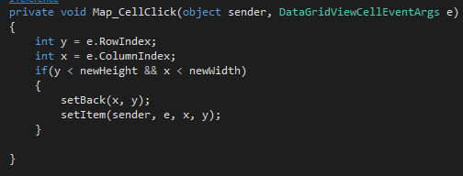
Level Designer Code Static
When the “generate” button has been clicked, the “setCells” function is used, this will change the displayed images to show the map layout and attach a map click event. When an item is selected, there is a property that will change, once the click event is fired on a cell position, the width and height positions are passed and the current cell will be set as the selected item image.

Slide 35
Level Designer Must feature Static
Save and load “Works”
The save and load buttons are placed at the top and bottom. The save and load buttons use the File Handler provided by James Darley which will save the files as a text file and is able to load from a text file.

Slide 36
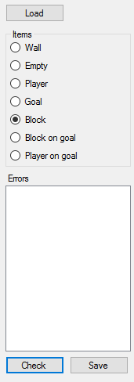
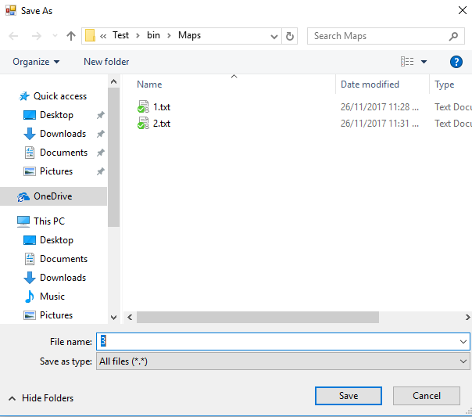
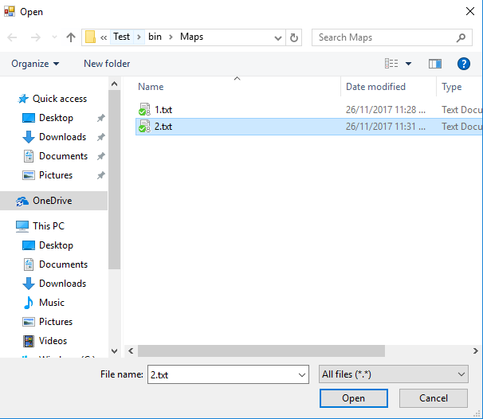
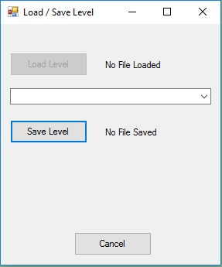
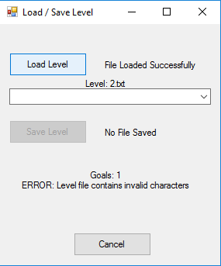
Level Designer Pictures Static
Fig 2. Save dialogs
Fig 3. Load dialogs
Fig 1. Save and load buttons

Slide 37
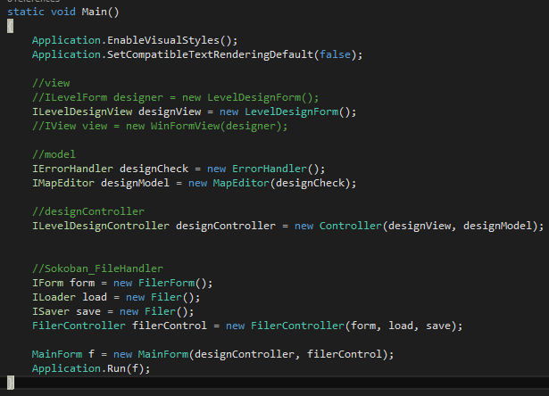
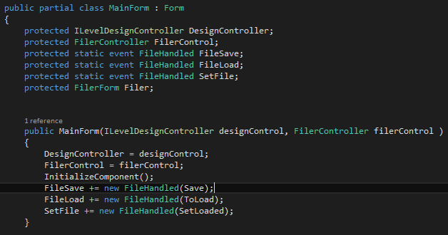
Level Designer Code Static
The file handler was injected into the main form, along with my level designer. This was done using a reference from one project to another, then created in the program class then injected into the main form.

Slide 38



Level Designer Code Static
When save is clicked from the view, this will call a static function from the parent form, Main Form, when the function is called, the event is triggered. The triggered event is attached to a delegate, the delegate defines the function that will run when the event is triggered, which is set to the Save() function. After this the file handler takes over.
The delegate being used
The property for the event
View save button click function
Delegate function being assigned
The static method being called
Function being called from the delegate which will pass the map to be saved

Slide 39



Level Designer Code Static
When load is clicked from the view, this will call a static function from the parent form, Main Form, when the function is called, the event is triggered. The triggered event is attached to a delegate, the delegate defines the function that will run when the event is triggered, which is set to the Load() function. After this the file handler takes over.
The delegate being used
The property for the event
View load button click function
Delegate function being assigned
The static method being called
Function being called from the delegate which will pass the map to be saved

Slide 40


Level Designer Code Static
Within the file handler controller, it will call a static function in the main form that will trigger the event, the event is attached to a delegate that is assigned the function that will then get the loaded array and load it into the level designer
The static function being called from the file handler
Function being called from the delegate that will load the map from the file handler to the level designer
Event that is attached to the delegate

Slide 41
Level Designer Must feature Static
“Useful” warnings
An error handler has been included with the model, this will run various tests. Each error will be added to the error list. The errors are as follows:
No player present
Not enough blocks
Too many players exist
There are no goals

Slide 42
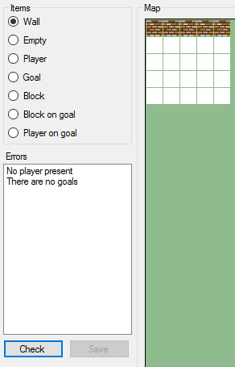
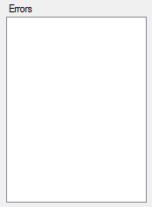
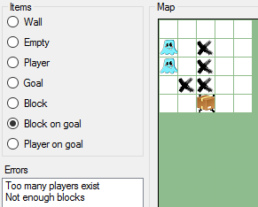
Level Designer Pictures Static
Fig 1. Error display
Fig 3. Errors, “Too many players exist” and “Not enough blocks”
Fig 2. Errors, “No player present” and “There are no goals”

Slide 43
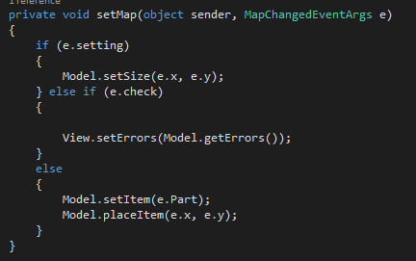
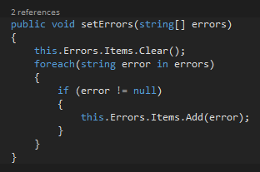
Level Designer Code Static
The view contains an event, that when triggered, will send specific data to the controller, if the check option equates to true, then it will get the errors from the model and send it to the view. The view will add that information into the error list.

Slide 44
Level Designer Should feature Static
Image replaces each item on view
When an item has been placed at a new position, that position will display the item image. There are different images set to the different items that can be selected.

Slide 45
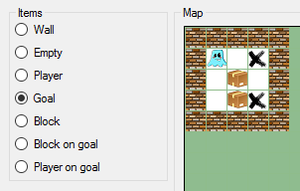
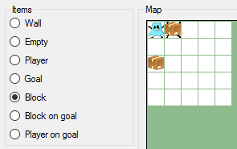
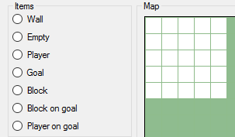
Level Designer Images Static
Fig 2. Player, goals, wall and blocks placed on map
Fig 3. Player on goal, block on goal and box
Fig 1. No items placed

Slide 46
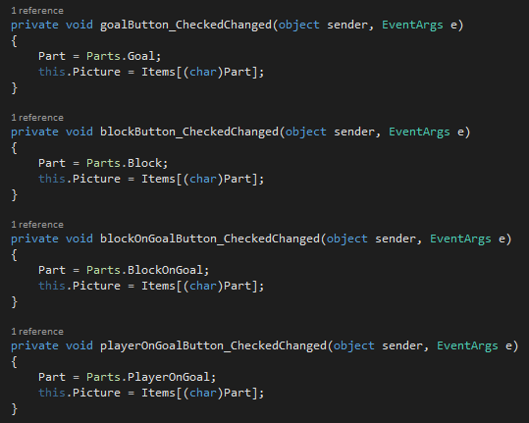
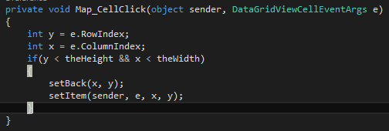
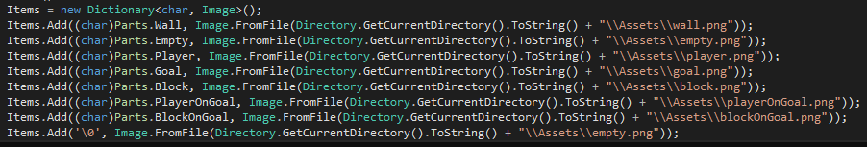
Level Designer Code Static
A dictionary gets defined and each item gets added when the start() function is run. The dictionary will correlate a character for each part with a specific image. When a position on the map is clicked, the cell image is set to the current part image.
View dictionary
When the cell is clicked the image is set and details sent to the model
Dictionary being defined and items being added to the dictionary in the start function
Current picture being set when the part is selected

Slide 47
Level Designer Should feature Static
Buttons are disabled when can’t be used
When the application starts, the generate and load buttons are the only available options. When the map has been generated the user can then click the “check” button to check for errors. When no errors are displayed, the save button will be enabled.

Slide 48
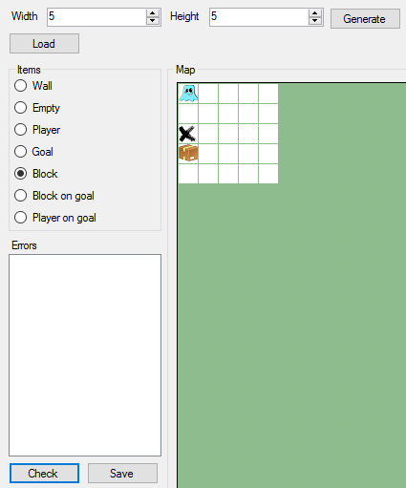
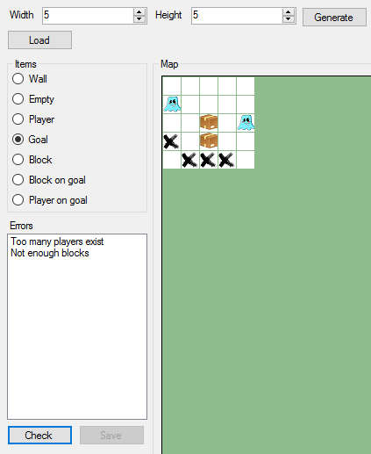
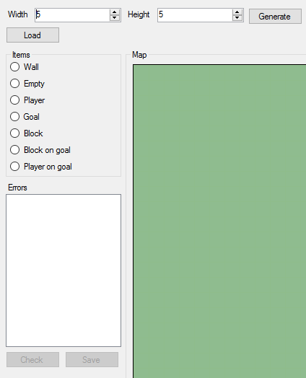
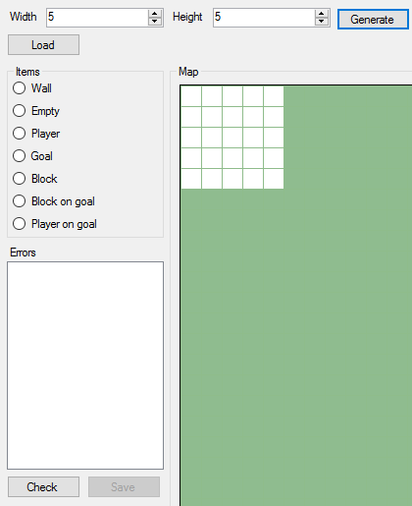
Level Designer Images Static
Clicking check, no errors
Starting the application
Clicking check, with errors
After clicking Generate

Slide 49


Level Designer Code Static
The default settings for the save and check buttons are set so that they are not enabled. When the generate button is clicked, the check button is enabled, the save button will always be disabled when generate is clicked as it creates an empty map, which should not be saved. The check button will be enabled, when there are no errors, save will be enabled.
The Generate click function, sets check and save
The Check click function, if no errors, show save button

Slide 50
Level Designer Must features Dynamic
Display a grid of variable size
Allow selection and placement of an item
Overlays old piece with new one
Save and load words
Useful warnings
No goals
No player
Too many players
Not enough blocks

Slide 51
Level Designer Should Dynamic
Each item placed displays an image
Buttons can only be clicked when valid
When map has been generated ‘check’ can be clicked
When there are no errors, save can be clicked

Slide 52
Level Designer Must feature Dynamic
Display grid of variable size
The map grid is generated after setting a size for the width and height of the level then clicking the ‘generate’ button. For the dynamic view, nothing is pre-existing on the form, each item is generated as a form panel type and placed at a specific point on the Map display area.

Slide 53



Level Designer Pictures Dynamic
Fig 1. When starting the designer
Fig 2. After clicking generate
Fig 3. Changing width and clicking generate

Slide 54



Level Designer Code Dynamic
A container is first defined, when the application starts this is empty. When the user enters a width and height, this gets passed to a set panels function. The set panels function will use a function that creates each panel matching the width and height.
The container for each map position
The create panel function, sets position and attaches event
The set panel function

Slide 55
Level Designer Must feature Dynamic
Allow selection and placement of a piece
Overlays old piece with a new one
There is a selection panel that will only allow a single item to be selected at a time, when something is selected and a position on the map is clicked, the background will change to suit the selected item. As each item is placed, it will overwrite the previous value whether it is empty or contains another piece.

Slide 56


Level Designer Pictures Dynamic
Selection panel
Item has been clicked and placed in the map
Wall item has been overwritten with a player selection

Slide 57



Level Designer Code Dynamic
When the “generate” button has been clicked, the set panels function is used, this will use a function to create the panel and attach an event. When an item is selected, there is a property that will change, when the click event is fired on a panel position, the width and height positions are passed and the current panel will be set as the selected item image.
When a panel is clicked the selected part will be set as the background
When generate is clicked each panel is made
Each panel is attached to a set back event

Slide 58
Level Designer Must feature Dynamic
Save and load “Works”
The save and load buttons are placed at the top and bottom. The save and load buttons use the File Handler provided by James Darley which will save the files as a text file and is able to load from a text file.

Slide 59
Level Designer Pictures Dynamic
Fig 2. Save dialogs
Fig 3. Load dialogs
Fig 1. Save and load buttons

Slide 60
Level Designer Code Dynamic
The file handler was injected into the main form, along with my level designer. This was done using a reference from one project to another, then created in the program class then injected into the main form.

Slide 61
Level Designer Code Dynamic
When save is clicked from the view, this will call a static function from the parent form, Main Form, when the function is called, the event is triggered. The triggered event is attached to a delegate, the delegate defines the function that will run when the event is triggered, which is set to the Save() function. After this the file handler takes over.
The delegate being used
The property for the event
View save button click function
Delegate function being assigned
The static method being called
Function being called from the delegate which will pass the map to be saved

Slide 62
Level Designer Code Dynamic
When load is clicked from the view, this will call a static function from the parent form, Main Form, when the function is called, the event is triggered. The triggered event is attached to a delegate, the delegate defines the function that will run when the event is triggered, which is set to the Load() function. After this the file handler takes over.
The delegate being used
The property for the event
View load button click function
Delegate function being assigned
The static method being called
Function being called from the delegate which will pass the map to be saved

Slide 63
Level Designer Code Dynamic
Within the file handler controller, it will call a static function in the main form that will trigger the event, the event is attached to a delegate that is assigned the function that will then get the loaded array and load it into the level designer
The static function being called from the file handler
Function being called from the delegate that will load the map from the file handler to the level designer
Event that is attached to the delegate

Slide 64
Level Designer Must feature Static
“Useful” warnings
An error handler has been included with the model, this will run various tests. Each error will be added to the error list. The errors are as follows:
No player present
Not enough blocks
Too many players exist
There are no goals

Slide 65


Level Designer Pictures Static
Error display
Errors, “Too many players exist” and “Not enough blocks”
Errors, “No player present” and “There are no goals”

Slide 66
Level Designer Code Dynamic
The view contains an event, that when triggered, will send specific data to the controller, if the check option equates to true, then it will get the errors from the model and send it to the view. The view will add that information into the error list.

Slide 67
Level Designer Should feature Static
Image replaces each item on view
When an item has been placed at a new position, that position will display the item image. There are different images set to the different items that can be selected.

Slide 68



Level Designer Images Dynamic
Fig 2. Player, goals, wall and blocks placed on map
Fig 3. Player on goal, block on goal and block
Fig 1. No items placed

Slide 69

Level Designer Code Static
A dictionary gets defined and each item gets added when the start() function is run. The dictionary will correlate a character for each part with a specific image. When a position on the map is clicked, the cell image is set to the current part image.
View dictionary
When the panel is clicked the image is set and details sent to the model
Dictionary being defined and items being added to the dictionary in the start function
Current picture being set when the part is selected

Slide 70
Level Designer Should feature Dynamic
Buttons are disabled when can’t be used
When the application starts, the generate and load buttons are the only available options. When the map has been generated the user can then click the “check” button to check for errors. When no errors are displayed, the save button will be enabled.

Slide 71




Level Designer Images Static
Clicking check, no errors
Starting the application
Clicking check, with errors
After clicking Generate

Slide 72

Level Designer Code Static
The default settings for the save and check buttons are set so that they are not enabled. When the generate button is clicked, the check button is enabled, the save button will always be disabled when generate is clicked as it creates an empty map, which should not be saved. The check button will be enabled, when there are no errors, save will be enabled.
The Generate click function, sets check and save
The Check click function, if no errors, show save button

Slide 73
File Handler Must features Static
Displays a file load dialog
Displays a file save dialog
Displays a list of files
Allows cancel
Provides path to most recent file

Slide 74
File Handler Should Static
Can click most recent link to load it
Error messages for whether file saved

Slide 75
File Handler Must feature Static
Display file load dialog
The file load dialog is shown when the user needs to load a file. The user will have to click the load button before it is created then shown to the user

Slide 76



File Handler Pictures Static
The load dialog display
The file handler dialog box
File handler dialog after loading file

Slide 77

File Handler Code Static
When the Load button is pressed the load dialog box is generated, once a file is clicked and the user presses open it will pass the file location to the file handler
The load dialog display is created then properties are set to define the file types and filter index. When a user has selected a valid file it will return the file location

Slide 78
File Handler Must feature Static
Display file save dialog
The save load dialog is shown when the user needs to save a file. The user will have to click the save button before it is created then shown to the user

Slide 79



File Handler Pictures Static
The save dialog display
The file handler dialog box
File handler dialog after saving file

Slide 80

File Handler Code Static
When the save button is pressed the save dialog box is generated, once a name has been entered and the user presses save, it will pass the file location to the file handler
The save dialog display is created, then properties are set to define the file types and filter index. When a user has selected a valid file it will return the file location

Slide 81
File Handler Must feature Static
Displays list of files
When the File Handler dialog is open, it will display a list of files in a defined folder. It will be generated onto a list box with just the file name, not the entire directory

Slide 82



File Handler Pictures Static
File Handler dialog with empty list of files
After saving a file
After saving multiple files

Slide 83



File Handler Code Static
When the file handler is loaded the list is populated, when the user loads or saves a file the list will be repopulated
Function is called when the form is created
Function runs when the save button is clicked, so newly saved items are also added
The file list is first cleared, the location is set and each file in the location is returned before adding them into the list

Slide 84
File Handler Must feature Static
Allows cancel
When the File Handler dialog is open, it will display a cancel button, this will hide the file dialog display. This is because only one instance is injected and another will not be generated when it is closed. The exit button for the window has been disabled to the form does not get disposed.

Slide 85
File Handler Pictures Static
File Handler dialog with cancel button and no exit for the window

Slide 86



File Handler Code Static
The cancel button is a drag and drop element with a changed id and cancel placed as the text. When the button is clicked it will use the forms built in hide() function.
Element being created
Element defined settings
Element attached event

Slide 87
File Handler Must feature Static
Provides path to most recent file
When the File Handler dialog is open, it will display a label with the most recent file location. If it is the first time it will display “recent file”, after an item is saved it will change to the most recent file directory

Slide 88


File Handler Pictures Static
When a file is saved
First time the File Handler is opened

Slide 89


File Handler Code Static
The label is updated when a function is used, it will get the path and change the label text to match the file pathway.
Element being created
Element defined settings
Element attached event

Slide 90

File Handler Code Static
The function will get the file in the parent directory that stores the recent saves, then get the last line of text and update the text property to that value

Slide 91
File Handler Should feature Static
Can click most recent link to load it
When the File Handler dialog is open, it will display a label link, when clicked, it will instantly load the designated file. The file will be the latest saved or loaded file

Slide 92

File Handler Pictures Static
After clicking the link, the file is loaded
First time the File Handler is opened it displays ‘no file’
When a file is saved it will change to the file name

Slide 93


File Handler Code Static
The link label is disabled when the form is created. When the recent file function is run, it will trigger the set recent link function. This will change the text to the file name.
The link is disabled when it is initialized
Recent file function containing the set recent link function

Slide 94

File Handler Code Static
Change the link text to the last item in the recent saves

Slide 95


File Handler Code Static
When the link is clicked it will run an event, the event will set the filename property to the most recent file before triggering another event. This event will load the file from the controller
Link click event setting the filename, creating event and triggering the event property. Once the second event is complete, it will check the file location to see if it exists then output the correct error.
The second event, loading in the file

Slide 96
File Handler Should feature Static
Error messages for whether file was saved
When a file is saved, a function will check whether or not the file exists before outputting the correct error message

Slide 97



File Handler Pictures Static
File not saved error
First time the File Handler is opened
File saved, success

Slide 98


File Handler Code Static
When the save button is clicked and the file should have been saved, it will run a check called file exists saved, this will check the file path and if it exists, will output the appropriate message to the list box, if it does not exist, then it will output the error.
Save button click function, when file should have been saved run check
The check that will update the list box with the appropriate message

Slide 99
Combined Application Must features Static
Must be able to access all three components
Level editor must load map
Level editor must save map
Game must load map
Game must save current map state

Slide 100
Combined Application Should features Static
Can test map without saving it

Slide 101
Combined Application Must feature Static
Must be able to access all three components
When the application is run, a main form will appear. The game and level editor are options in a drop down menu. When the level editor is selected it will show as a child of the main form, selecting the game will show the game as a child of the form. When save or load are selected, the file handler will be displayed as its own form that will remain in from of all other forms.

Slide 102


Combined Application Pictures Static
Form view when the application starts, parent form
Level designer is shown as a child within the parent form

Slide 103


Combined Application Pictures Static
Level designer is shown as a child within the parent form
File handler being shown when loading or saving in the level designer

Slide 104

Combined Application Code Static
Before the application starts, each class is created and injected into the appropriate way. This creates a single instance of each object

Slide 105



Combined Application Code Static
This allows the main form to access the required views or functions needed. The main form will show the correct form based on what is selected in the drop down menu
When the main form option for level designer is clicked, a function in the controller is called
The view will set the parent and show the form within the parent form
The level design controller will pass the parent form to the view

Slide 106

Combined Application Code Static
When the main form option for the game is clicked, the show function is called directly on the form

Slide 107
Combined Application Must feature Static
Level editor must save map
When using the level editor, the user must be able to save a file using the file handler dialog

Slide 108



Combined Application Pictures Static
Generated file at file location
Level editor after clicking save
File handler after saving “Save File”

Slide 109



Combined Application Code Static
When clicking save in the level editor, it will invoke a static method with the main form, this will trigger an event that passes no information. The event is attached to a delegate, the delegate has a function attached to it
Invoking the static method
Delegate defined in namespace
Main form static method

Slide 110


Combined Application Code Static
Event delegate attached to save function
Save function

Slide 111



Combined Application Code Static
The save function will show the file handler form, get the map from the level designer and pass it to the file handler
Shows the file handler form
Passes the map to a model function while disabling the load button and enabling the save button
Sets the model map array

Slide 112
Combined Application Code Static
When the file handler is open, the user must click the file handler save button. This will start the series of functions/events needed to convert and save the file. The message list will first be cleared of previous messages before a save dialog being made, the dialog properties will be set, then the recent save file will be defined.
When the user has specified the save file location and name, an event is triggered that will save the map which was previously passed. The saving function is part of my file handler as mentioned previously.

Slide 113

Combined Application Code Static

Slide 114
Combined Application Must feature Static
Game must load map
The file load dialog is shown when the user needs to load a file. The user will have to click the load button before it is created then shown to the user

Slide 115



Combined Application Pictures Static
Level designer loaded map
Level editor after clicking load
File handler after loading “Save File”

Slide 116


Combined Application Code Static
When clicking load in the level editor, it will invoke a static method with the main form, this will trigger an event that passes no information. The event is attached to a delegate, the delegate has a function attached to it
Invoking the static method and show check
Delegate defined in namespace
Main form static method

Slide 117


Combined Application Code Static
Event delegate attached to ‘to load’ function
To load function

Slide 118


Combined Application Code Static
The to load function will show the file handler form, while disabling or enabling the appropriate buttons
Will disable the save button and enable the load button
Will show the file handler form

Slide 119
Combined Application Code Static
When the file handler is open, the user must click the file handler load button. This will start the series of functions/events needed to load the file. The load dialog will be made before the message list is cleared of previous messages, the dialog properties will be set, then the recent save file will be defined and checked.
When the user has specified the load file, an event is triggered that will load the file. The loading function is part of my file handler as mentioned previously.

Slide 120
Combined Application Must feature Static
Game must save current map state
The Game portion was provided by Jonathan Bray. The file handler was already implemented before I moved the required code around to make it work with my file handler and level designer. The game must be able to save with the position of parts when they move around.

Slide 121




Combined Application Pictures Static
Game started, loaded ‘save file’
Changed player and block positions, saved the file as “test”
Loaded the test file
File created

Slide 122

Combined Application Code Static
Clicking the save button create a save dialog, set the properties then get the user to define the file name and location, once this is returned it will be passed to the controller along with the game model
Save button click event function

Slide 123



Combined Application Code Static
The function in the controller will set the file property to the filename and invoke the static function in the main form
Function called in controller, invokes the main form function
Triggers delegate attached to the save file function
Sets off an event

Slide 124


Combined Application Code Static
The save file function will get the saved file location and the game model before passing it to the ‘game_save’ function in the file handler controller
Save file function, passing save file location and game model
Passes the filename and game model to filer model

Slide 125

Combined Application Code Static
The provided file handler saving the map at the passed file location after converting the game map locations to a text file

Slide 126
Theory Compare/Contrast Languages
Compare and contrast the features and uses of different programming languages
I will compare different languages with getting the current folder directory, the languages I will look at are:
C#
PHP
Javascript
Python
This will be followed by examples used in my code

Slide 127
Theory Compare/Contrast Languages C#
C# contains a built in framework, a ‘Directory’ class. When “Using System.IO” to access the designated namespace, static methods become accessible. One of the functions that can be used is called ‘GetCurrentDirectory()’. This will return the current directory location as a string. To use the function, it must be prefixed with the ‘Directory’ keyword after using the namespace e.g.
Using System.IO;
Directory.GetCurrentDirectory();
Microsoft. (n.d.). Directory Class. Retrieved November 28, 2017, from Developer Network: https://msdn.microsoft.com/en-us/library/system.io.directory(v=vs.110).aspx
Microsoft. (n.d.). Directory.GetCurrentDirectory Method (). Retrieved November 28, 2017, from Developer Network: https://msdn.microsoft.com/en-us/library/system.io.directory.getcurrentdirectory(v=vs.110).aspx

Slide 128
Theory Compare/Contrast Languages PHP
PHP contains a magic constant, __DIR__. This will return the directory of the file it is currently being used from as a string. A magic constant is just a predefined constant that will change depending on where it is used.
Another PHP method that can return the same result is getcwd(). Which will get the current working directory as the string path.
PHP. (n.d.). Magic constants. Retrieved November 28, 2017, from PHP: http://php.net/manual/en/language.constants.predefined.php
PHP. (n.d.). getcwd. Retrieved November 28, 2017, from PHP: http://php.net/manual/en/function.getcwd.php

Slide 129
Theory Compare/Contrast Languages Javascript
In Javascript there is no predefined function that will return the current directory; however, there is a way to get the file location. After this is done the end of the string can be removed to get the file location e.g.
Var location = location.pathname
//this will return a string with the filename at the end
Var directory = location. substring(0, loc.lastIndexOf('/'));
//this will remove everything after the last slash, returning the current directory
W3Schools. (n.d.). Location pathname Property. Retrieved November 28, 2017, from W3Schools: https://www.w3schools.com/jsref/prop_loc_pathname.asp
W3Schools. (n.d.). JavaScript String substring() Method. Retrieved November 28, 2017, from W3Schools: https://www.w3schools.com/jsref/jsref_substring.asp

Slide 130
Theory Compare/Contrast Languages Python
Python contains a similar function to php, getcwd(), which is used to return the current working directory. This requires the use of pythons OS module which provides a way to use operating system dependent functionality. Use of the function requires import os before running the command e.g.
Import os
directory = os.getcwd()
This will return the current working directory of a process
Tutorials Point. (n.d.). Python os.getcwd() Method. Retrieved November 28, 2017, from Tutorials Point: https://www.tutorialspoint.com/python/os_getcwd.htm
Python For Beginners. (n.d.). Python's OS Module. Retrieved November 28, 2017, from Python For Beginners: http://www.pythonforbeginners.com/os/pythons-os-module

Slide 131
Theory Compare/Contrast Languages Implemented
During the process of creating the file handler, the current directory was needed get the directory so a file or another directory could be created. The PHP Directory.GetCurrentDirectory() was placed inside another function and used at several points in the file handlers model

Slide 132

Theory Compare/Contrast Languages Code
The get current directory function being used to get the file path and create a directory and setting the save location

Slide 133
Theory Compare/Contrast Languages Alternative
Another approach to getting the current directory location would be to use the Environment.CurrentDirectory property, as the current directory can be obtained or set whether you get the value or set it; however, this approach does not have a defined get and set method, whereas Directory.GetCurrentDirectory() is an explicitly defined getter and Directory.SetCurrentDirectory() is the defined setter. My approach was appropriate in regards to using an explicitly defined function.

Slide 134
Theory Compare/Contrast Languages Improvement
When using the Directory.GetCurrentDirectory() function, it is defined in a another function that gets called. This could have been defined as a property instead as it gets generated each time the function is called. Defining a property in the file handler class will just hold the data and it can be accessed at any time

Slide 135
Self Marking
Code | Marks | Reason
File Handler Model | 8 | Did > 20 Must features
Level Designer Static View | 7 | Only did 2 should features
Level Designer Dynamic View | 7 | Only did 2 should features
File Handler Static View | 7 | Only did 2 should features
Combine all three components | 5 | Only managed to complete Must features
Compare/Contrast languages | 5 | Answered each point

